Slide 1
Finance 101
Presented By:-
Parth Dave(100873777)
Tahseen Siddiqi(100889810)
Mikhil Lal(100863785)
Yashika Goel(100848238)

Slide 2
Web Scraping
Highlights
Created independent Web scraping module.
Scraped 50 pages.
Stored data in a dataframe and imported to csv.
Features
Added logging/warning.
Added try exception
Added multiprocessing/concurrent programing.
Used map module which checks for connection timeout by default.
Calculating time for processes with or without multi processing.
Github module link :-
https://github.com/parthdavework/FinanceAnlysisViaScrapping/blob/main/WebScraping/web_scraping.ipynb

Slide 3
Search Stock
Highlights
Searching TSX and storing news in a list.
Searching for tickers in that list and saving it.
Created and imported the tickers in dataframe and csv.
Features:
Right format.
Handling duplication.
Github module link:
https://github.com/parthdavework/FinanceAnlysisViaScrapping/blob/main/search_store_stock/search_stock.ipynb

Slide 4
Data Storage
Limitations
Cannot inherit or call ipynb files.
Storing csvs and call each time.
Features
All modules are connected.
Exception handling.
Github link for data:
https://github.com/parthdavework/FinanceAnlysisViaScrapping/tree/main/data_storage

Slide 5
Fetch Stock Data
Traditional Approach:
YFinance module
Another Approach:
Web API

Slide 6
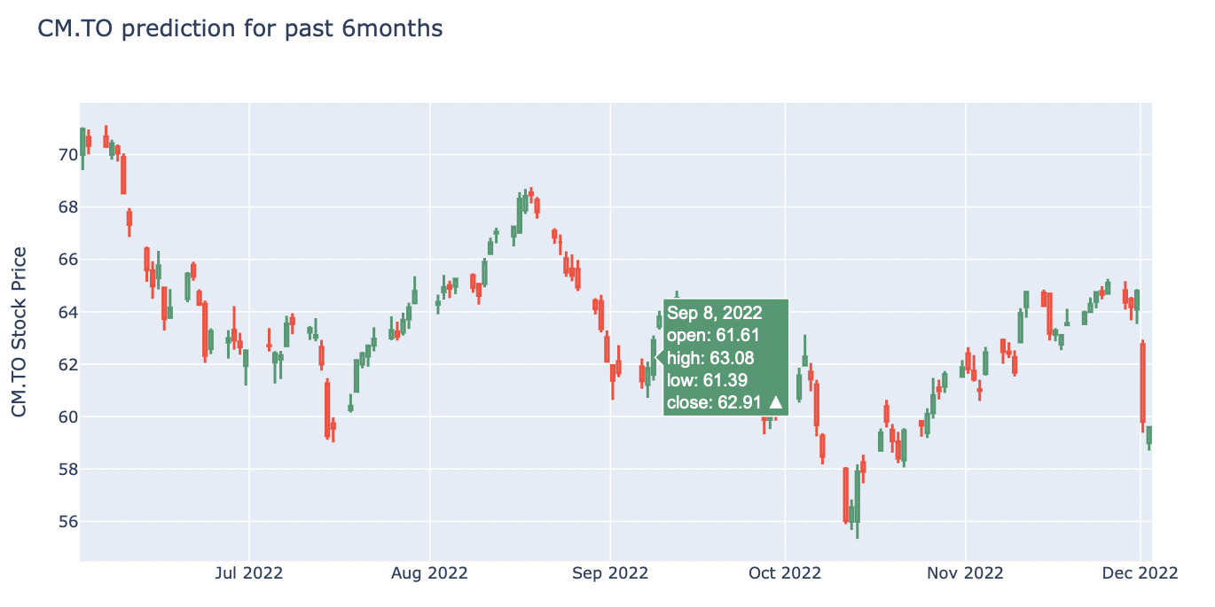
Visualisation
For Stock marketers

Slide 7
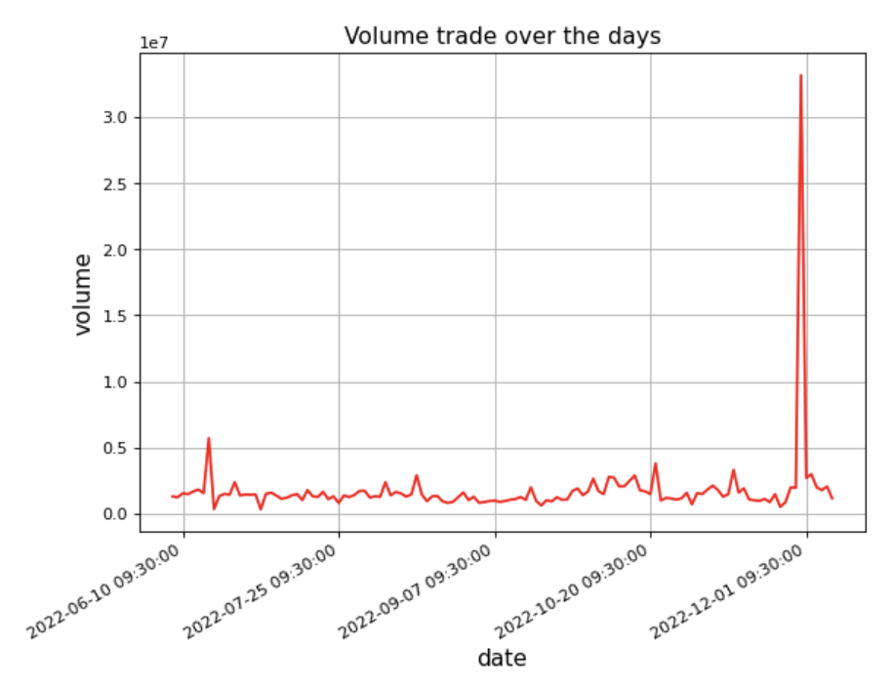
Continued…
Volume?

Slide 8
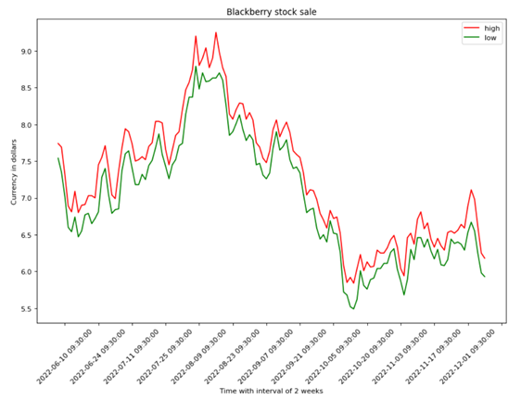
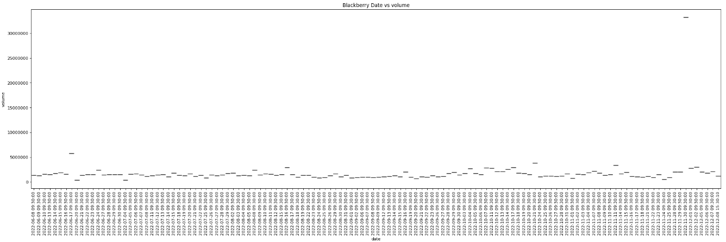
EDA of stocks
Blackberry (BB) is a Canadian Software company which is specialized in cybersecurity.
The stock sales for blackberry were highest on 30 Nov 2022 which was 6 times more than the normal trend and can see that the price gradually increased after some time after being low.

Slide 9
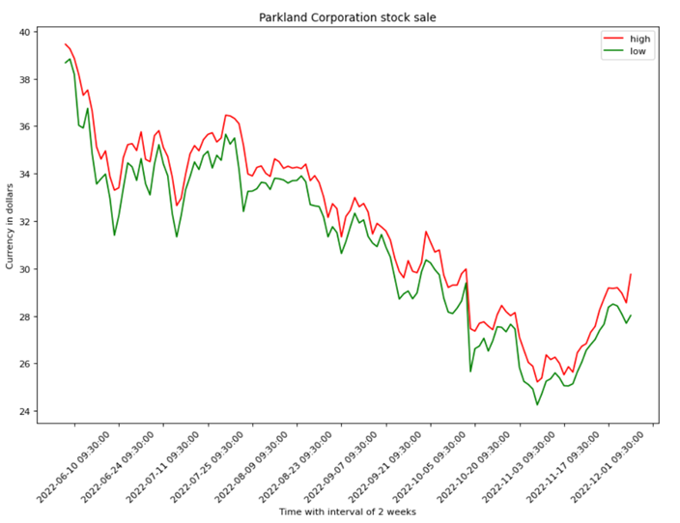
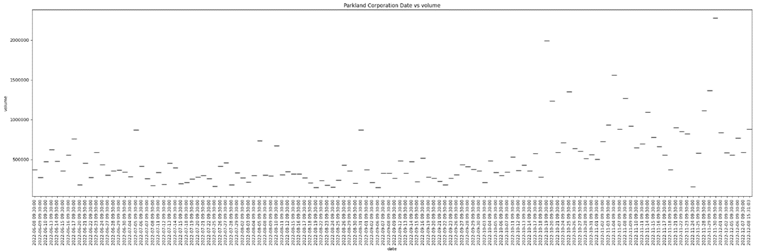
EDA of stocks
Parkland Corporation (PKI) is an Alberta-based energy and retail company, which operates various gas stations under them
The volume was highest on 20 Oct 2022 and 30 Nov. Again matching the high and low in the graph we can clearly see that the prices have increased on both dates after being low for some time.

Slide 10
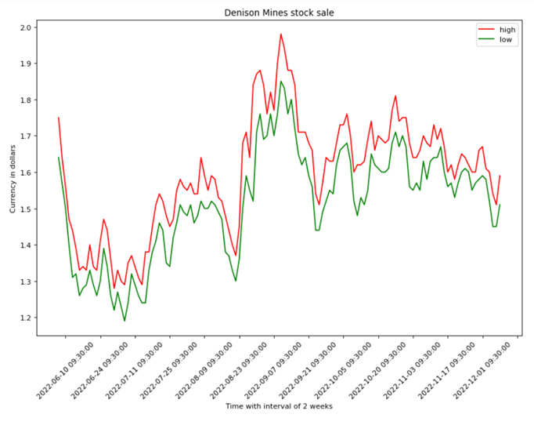
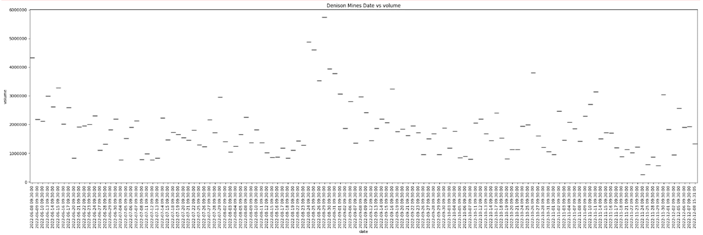
EDA of stocks
Denison Mines Corp.(DML) is a Canadian uranium exploration, development, and production company.
The volume can be seen highest on 29 august 2022. By checking on the price we can see that the prices were peak during this time from the high and low comparison.

Slide 11
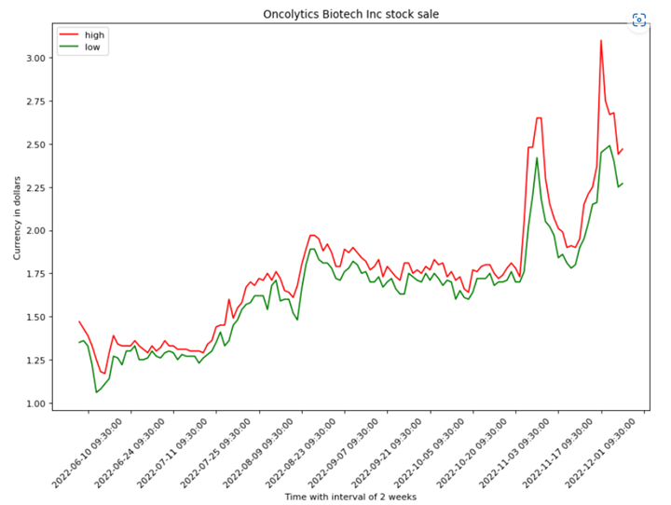
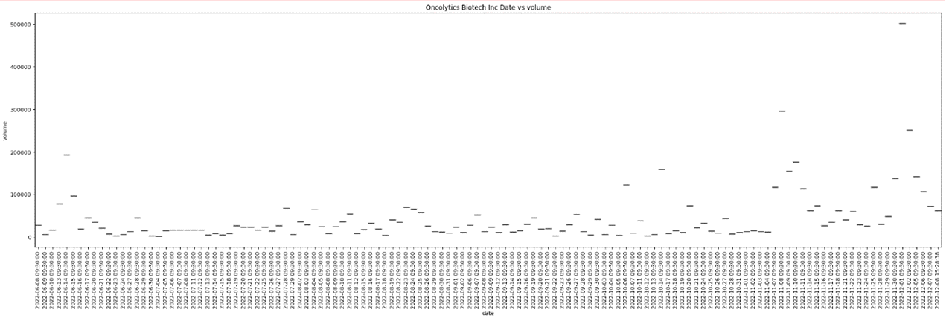
EDA of stocks
Oncolytics Biotech Inc (ONC) is a Canadian company, that is developing a virus called pelareorep for the treatment of solid tumors and hematological malignancies
The volume was highest on the 1st of December 2022 and it is clear that the stock price was high during the same period, from the high and low comparison graph.

Slide 12
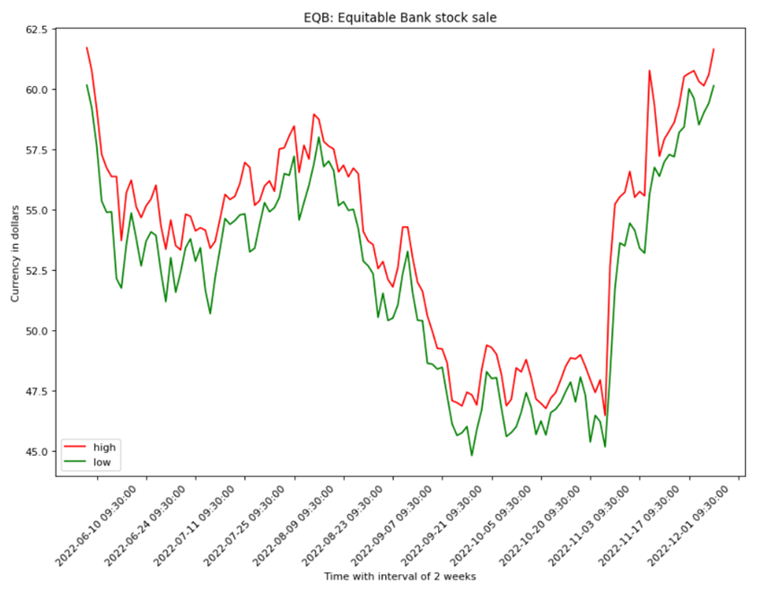
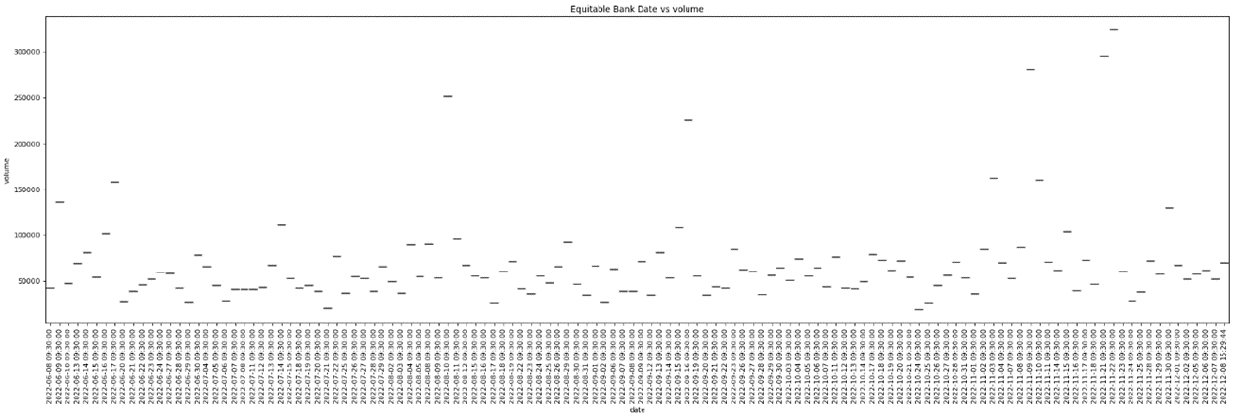
EDA of stocks
Equitable Bank (EQB) is a Canadian bank that primarily provides residential and commercial real estate lending services
Volumes high between 20 and 22 Nov. We had a price surge in the stock price during the same time.

Slide 13
THANK YOU

